Slide 1
Representation Learning on Networks
Yuxiao Dong
Microsoft Research, Redmond
Joint work with Kuansan Wang (MSR);
Jie Tang, Jiezhong Qiu, Jie Zhang, Jian Li (Tsinghua University); Hao Ma (MSR & Facebook AI)

Slide 2






Microsoft Academic Graph
664,195 fields of study
48,728 journals
4,391 conferences
219 million papers/patents/books/preprints
240 million authors
25,512 Institutions
https://academic.microsoft.com as of May 25, 2019

Slide 3
Example 1: Inferring Entities’ Research Topics
CS
Math
Physics, Math
?
Physics
Biology
?
240 million authors
Shen, Ma, Wang. A Web-scale system for scientific knowledge exploration. ACL 2018

Slide 4
Example 2: Inferring Scholars’ Future Impact
?
?
Dong, Johnson, Chawla. Will This Paper Increase Your h-index? Scientific Impact Prediction. WSDM 2015.

Slide 5
Example 3: Inferring Future Collaboration
Dong, Johnson, Xu, Chawla. Structural Diversity and Homophily: A Study Across More Than One Hundred Big Networks. KDD 2017.

Slide 6



Example 3: Inferring Future Collaboration
P₁ ( | )
P₂ ( | )
Dong, Johnson, Xu, Chawla. Structural Diversity and Homophily: A Study Across More Than One Hundred Big Networks. KDD 2017.

Slide 7


Example 4: Inferring User Demographics
Dong, et al. Inferring User Demographics and Social Strategies in Mobile Social Networks. KDD 2014

Slide 8
Lots of Structural Features
Example 4: Inferring User Demographics
Given one node v and its ego network:
Individual feature:
Individual attribute: degree, neighbor connectivity, clustering coefficient, embeddedness and weighted degree.
Link feature:
Friend attribute: # of connections to female/male, young/young-adult/middle-age/senior friends (from labeled friends).
Dyadic factor: both labeled and unlabeled friends for social tie structures in v’s ego network.
Circle feature:
Circle attribute: # of demographic triads, i.e., v-FF, v-FM, v-MM; v-AA, v-AB, v-AC, v-AD, v-BB, v-BC, v-BD, v-CC, v-CD, v-DD. (A/B/C/C denote the young/young-adult/middle-age/senior)
Triadic factor: both labeled and unlabeled friends for social triad structures in v’s ego network.
LCR/SVM/NB/RF/Bag/RBF:
Individual/Friend/Circle Attributes
FGM/DFG
Individual/Friend/Circle Attributes
Structure feature: Dyadic factors
Structure feature: Triadic factors
Dong, et al. Inferring User Demographics and Social Strategies in Mobile Social Networks. KDD 2014

Slide 9
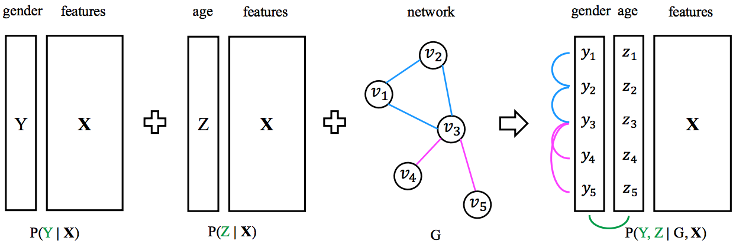
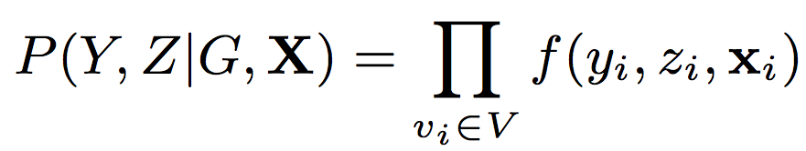
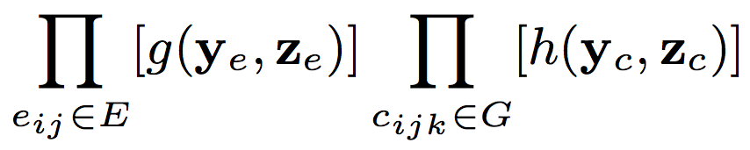
Machine Learning Model
Example 4: Inferring User Demographics
Code is available at: http://arnetminer.org/demographic

Slide 10
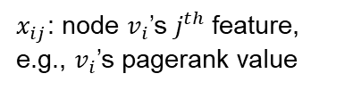
The network mining paradigm
$x_{ij}$: node $v_{i}$’s $j^{th}$feature, e.g., $v_{i}$’s pagerank value
Graph & network applications
Node label inference;
Link prediction;
User behavior… …
X
hand-crafted feature matrix
feature engineering
machine learning models

Slide 11
Representation learning for networks
Graph & network applications
Node label inference;
Node clustering;
Link prediction;
… …
Z
hand-crafted latent feature matrix
Feature engineering learning
machine learning models
Input: a network $G=(V, E)$
Output: $Z∈R^{\left|V\right|×k}, k≪|V|$, $k$-dim vector $Z_{v}$ for each node v.

Slide 12
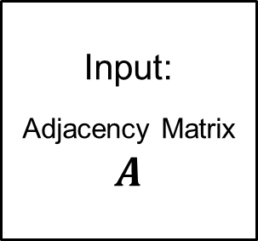
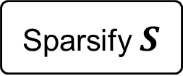
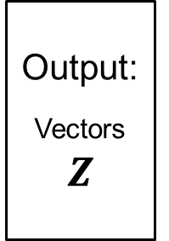
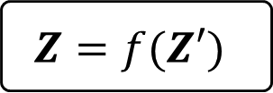
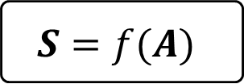
Network Embedding
Random Walk
Skip Gram
Input:
Adjacency Matrix
$$A$$
Output:
Vectors
$$Z$$
$$S=f(A)$$
(dense) Matrix Factorization
Sparsify $S$
(sparse) Matrix Factorization
(sparse) Matrix Factorization
$$Z=f(Z′)$$

Slide 13
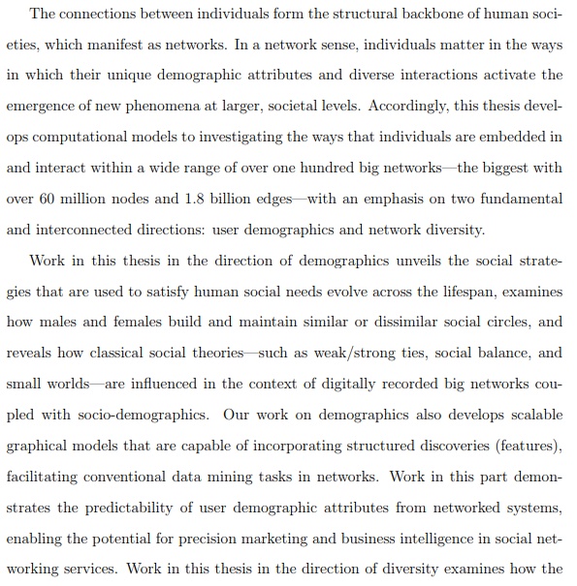
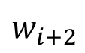
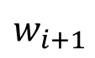
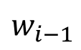
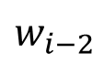
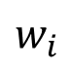
Word embedding in NLP
Input: a text corpus$D=\{W\}$
Output: $X∈R^{\left|W\right|×d}, d≪|W|$, $d$-dim vector $X_{w}$ for each word w.
Computational lens on big social and information networks.
The connections between individuals form the structural …
In a network sense, individuals matters in the ways in which ...
Accordingly, this thesis develops computational models to investigating the ways that ...
We study two fundamental and interconnected directions: user demographics and network diversity
... ...
$$w_{i−2 }$$
$$w_{i−1 }$$
$$w_{i}$$
X
$$w_{i+1 }$$
$$w_{i+2 }$$
sentences
Word embedding models
latent feature matrix
Harris’ distributional hypothesis: words in similar contexts have similar meanings.
Key idea: try to predict the words that surrounding each one.
Harris, Z. (1954). Distributional structure. Word, 10(23): 146-162.
Bengio, et al. Representation learning: A review and new perspectives. In IEEE TPAMI 2013.
Mikolov, et al. Efficient estimation of word representations in vector space. In ICLR 2013.

Slide 14
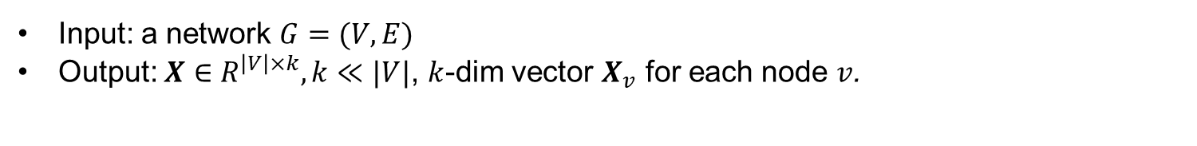
Network embedding
Input: a network $G=(V, E)$
Output: $X∈R^{\left|V\right|×k}, k≪|V|$, $k$-dim vector $X_{v}$ for each node $v$.
$$w_{i−2 }$$
Computational lens on big social and information networks.
… …
a
b
c
$$w_{i−1 }$$
d
e
f
$$w_{i}$$
g
h
$$w_{i+1 }$$
$$w_{i+2 }$$
sentences
skip-gram
hand-crafted latent feature matrix
Feature engineering learning

Slide 15
Network embedding: DeepWalk
Input: a network $G=(V, E)$
Output: $X∈R^{\left|V\right|×k}, k≪|V|$, $k$-dim vector $X_{v}$ for each node $v$.
$$w_{i−2 }$$
v₁
v₃
v₂
v₃
v₅
v₁
v₂
v₃
v₅
v₃
$$w_{i−1 }$$
$$w_{i}$$
v₁
v₃
v₅
v₃
v₄
$$w_{i+1 }$$
v₁
v₂
v₁
v₃
v₄
$$w_{i+2 }$$
sentences node-paths
skip-gram
hand-crafted latent feature matrix
Feature learning
Perozzi et al. DeepWalk: Online learning of social representations. In KDD’ 14, pp. 701–710. Most Cited Paper in KDD’14.

Slide 16
Distributional Hypothesis of Harris
Word embedding: words in similar contexts have similar meanings (e.g., skip-gram in word embedding)
Node embeddings: nodes in similar structural contexts are similar
DeepWalk: structural contexts are defined by co-occurrence over random walk paths
Harris, Z. (1954). Distributional structure. Word, 10(23): 146-162.

Slide 17
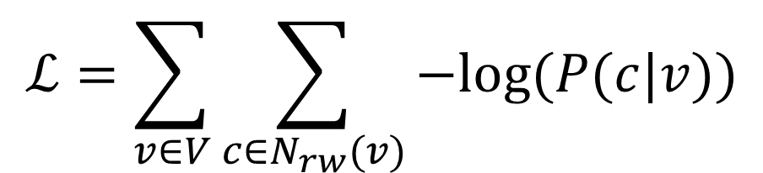
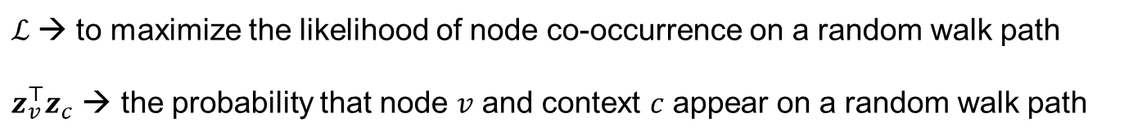
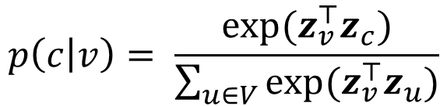
The main idea behind
$$ℒ=\sum_{v∈V}{\sum_{c∈N_{rw}(v)}{−log⁡(P(c|v))}}$$
$$p\left(c | v\right)= \frac{exp⁡(z_{v}^{⊤}z_{c})}{\sum_{u∈V}{exp⁡(z_{v}^{⊤}z_{u})}}$$
$ℒ$→ to maximize the likelihood of node co-occurrence on a random walk path
$z_{v}^{⊤}z_{c}$ → the probability that node $v$ and context $c$ appear on a random walk path

Slide 18
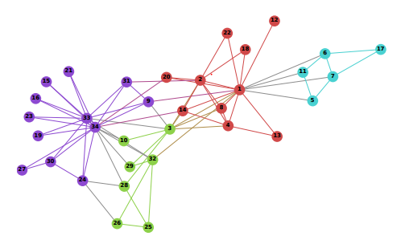
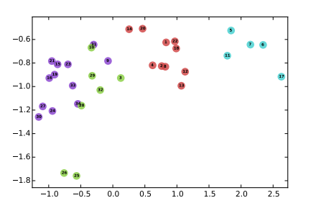
Network embedding: DeepWalk
Graph & network applications
Node label inference;
Node clustering;
Link prediction;
… …
Perozzi et al. DeepWalk: Online learning of social representations. In KDD’ 14, pp. 701–710. Most Cited Paper in KDD’14.

Slide 19
Random Walk Strategies
Random Walk
DeepWalk (walk length > 1)
LINE (walk length = 1)
Biased Random Walk
2nd order Random Walk
node2vec
Metapath guided Random Walk
metapath2vec

Slide 20
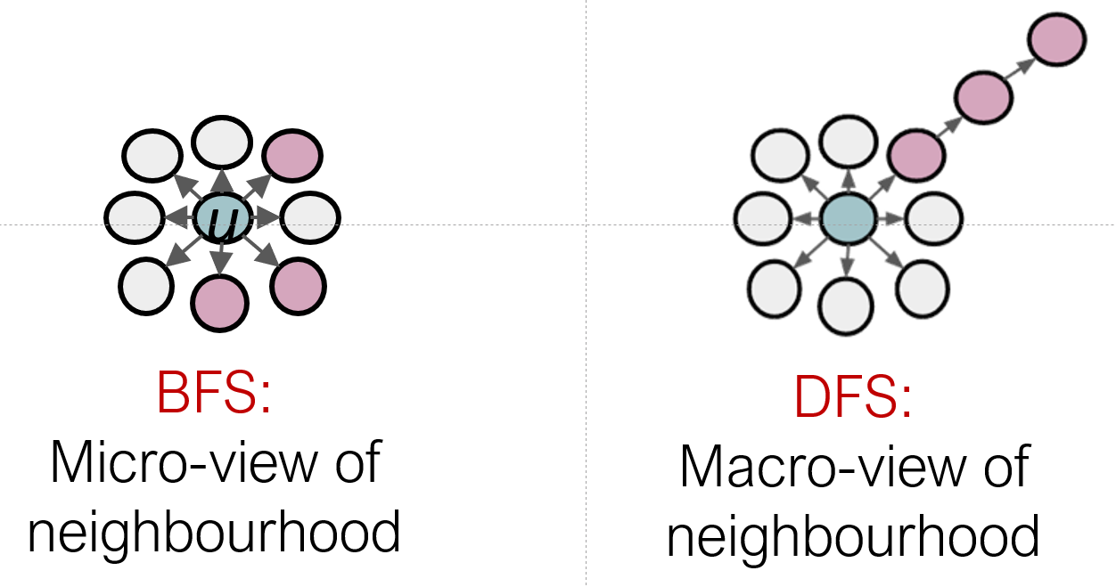
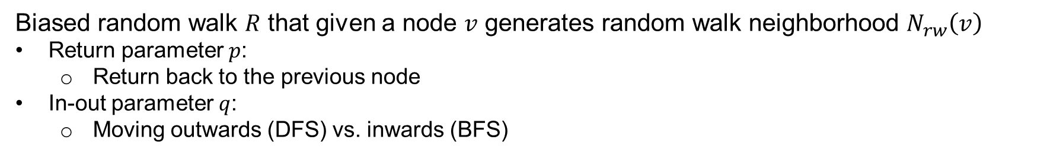
node2vec
Biased random walk $R$ that given a node $v$ generates random walk neighborhood $N_{rw}\left(v\right)$
Return parameter $p$:
Return back to the previous node
In-out parameter $q$:
Moving outwards (DFS) vs. inwards (BFS)
Picture snipped from Leskovec

Slide 21
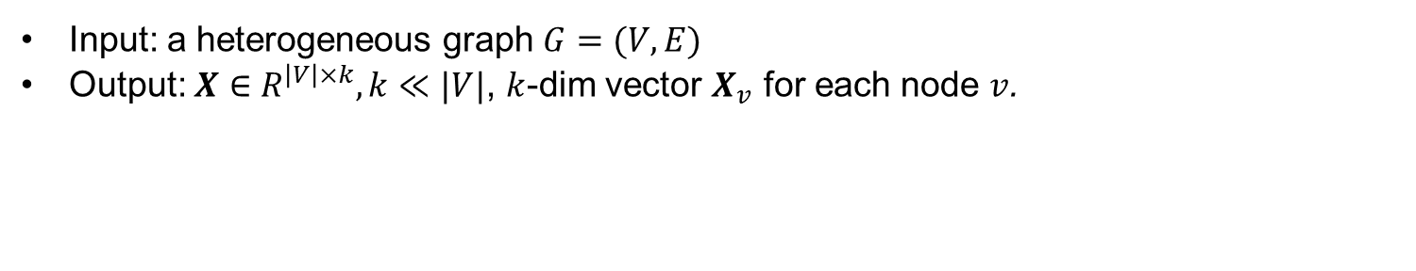
Heterogeneous graph embedding: metapath2vec
Input: a heterogeneous graph $G=(V, E)$
Output: $X∈R^{\left|V\right|×k}, k≪|V|$, $k$-dim vector $X_{v}$ for each node $v$.
meta-path-based random walks
heterogeneous skip-gram
Dong, Chawla, Swami. metapath2vec: Scalable Representation Learning for Heterogeneous Networks. KDD 2017

Slide 22
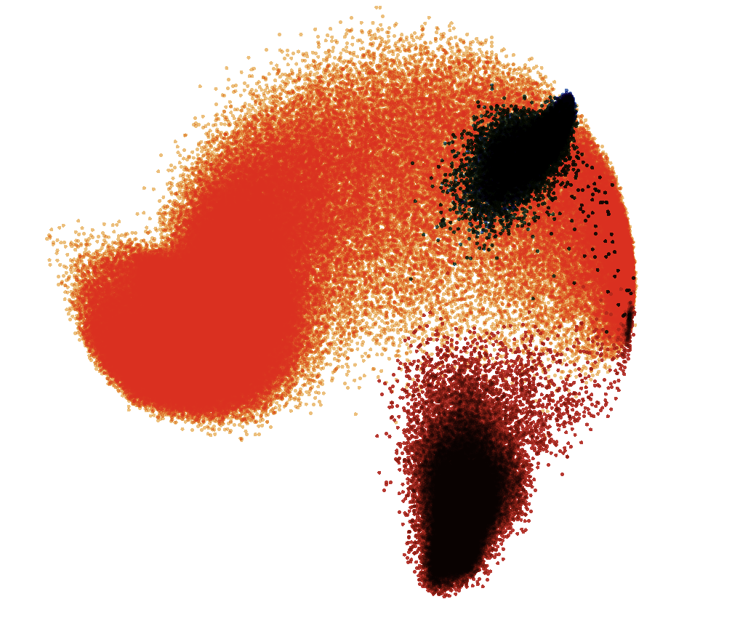
Application: Embedding Heterogeneous Academic Graph
fields of study
journal
conference
metapath2vec
paper/patent/book
affiliation
author
Microsoft Academic Graph
&
AMiner

Slide 23
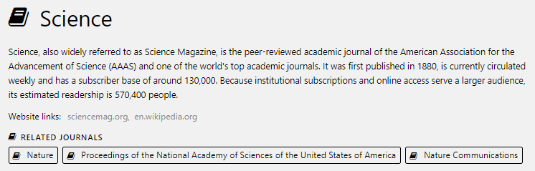
Application 1: Related Venues

Slide 24
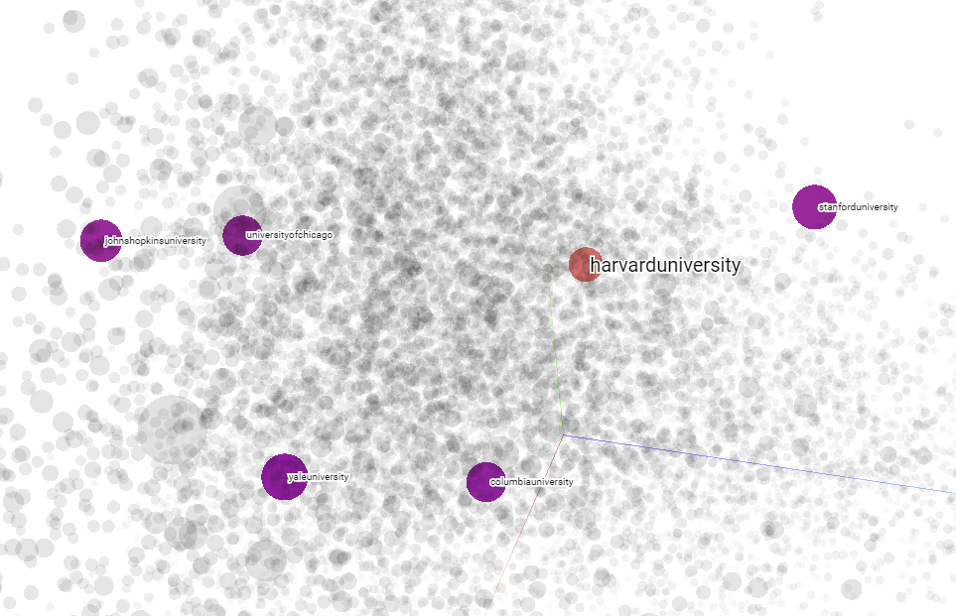
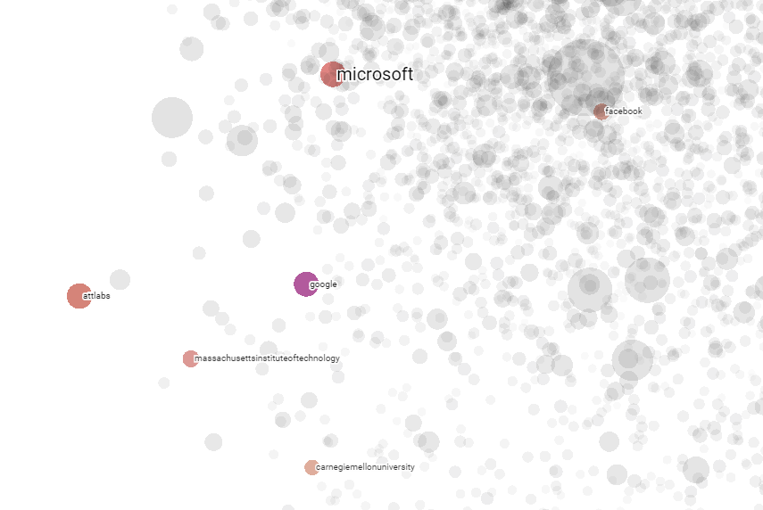
Application 2: Similarity Search (Institution)
Microsoft
Stanford
Facebook
Harvard
Johns Hopkins
UChicago
AT&T Labs
Google
MIT
Yale
Columbia
CMU

Slide 25
Network Embedding
Random Walk
Skip Gram
DeepWalk, LINE, node2vec, metapath2vec
Input:
Adjacency Matrix
$$A$$
Output:
Vectors
$$Z$$

Slide 26
What are the fundamentals
underlying random-walk + skip-gram based network embedding models?

Slide 27
Network embedding as matrix factorization: unifying deepwalk, line, pte, and node2vec
Qiu et al., Network embedding as matrix factorization: unifying deepwalk, line, pte, and node2vec. In WSDM’18.

Slide 28
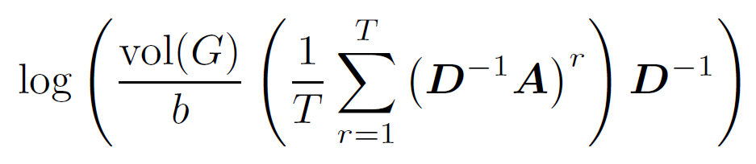
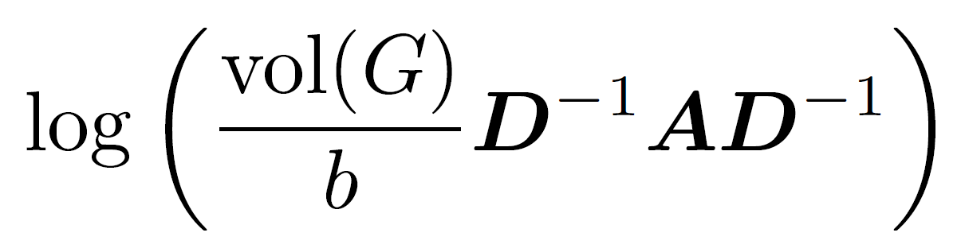
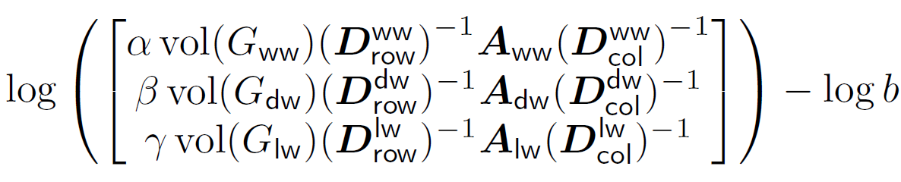
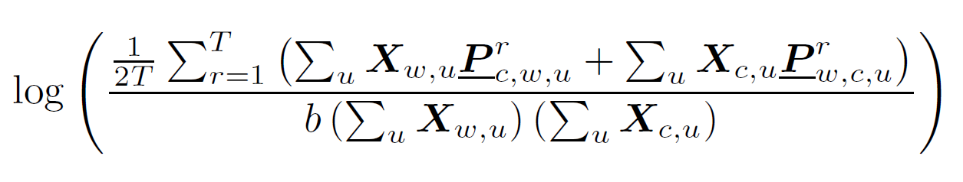
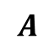
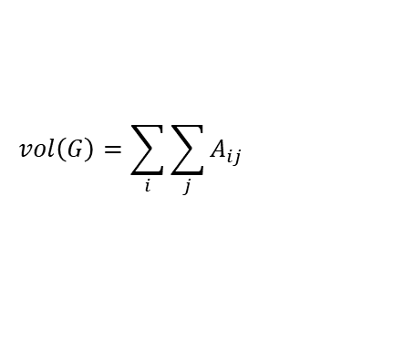
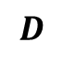
Unifying DeepWalk, LINE, PTE, & node2vec as Matrix Factorization
DeepWalk
The most cited paper in KDD14
LINE
The most cited paper in WWW15
PTE
The 5th most cited paper in KDD15
node2vec
The 2nd most cited paper in KDD16
$$A$$
Adjacency matrix
b: #negative samples
T: context window size
$$D$$
Degree matrix
$$vol\left(G\right)=\sum_{i}{\sum_{j}{A_{ij}}}$$
Qiu et al. Network embedding as matrix factorization: unifying deepwalk, line, pte, and node2vec. In WSDM’18. The most cited paper in WSDM’18 as of May 2019

Slide 29
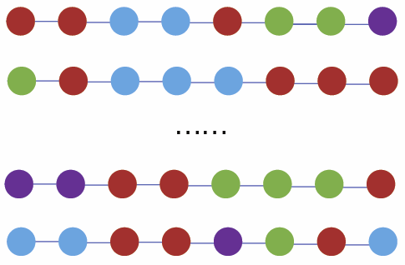
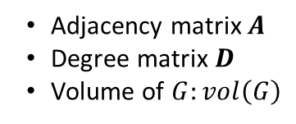
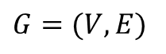
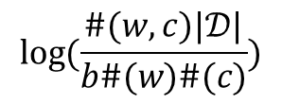
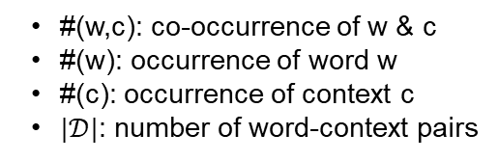
Understanding random walk + skip gram
$$w_{i−2 }$$
$$w_{i−1 }$$
$$w_{i}$$
$$w_{i+1 }$$
$$w_{i+2 }$$
$G=(V, E)$
?
#(w,c): co-occurrence of w & c
#(w): occurrence of word w
#(c): occurrence of context c
$|𝒟|$: number of word-context pairs
Adjacency matrix $A$
Degree matrix $D$
Volume of $G:vol\left(G\right)$
$$\log{(\frac{\#(w,c)|𝒟|}{b\#(w)\#(c)})}$$
Levy and Goldberg. Neural word embeddings as implicit matrix factorization. In NIPS 2014

Slide 30
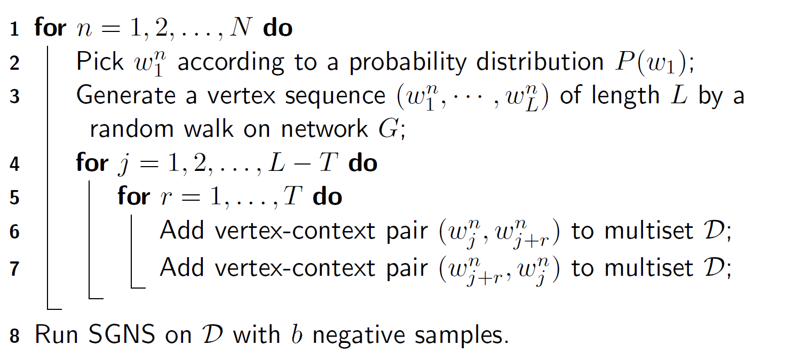
Understanding random walk + skip gram

Slide 31
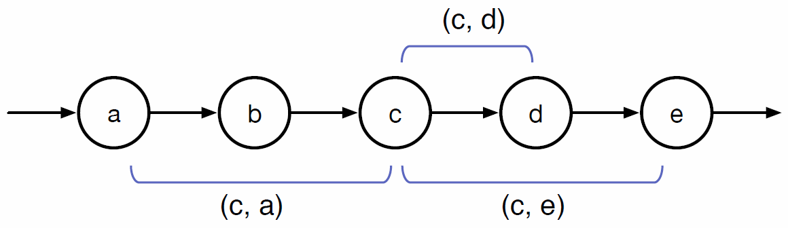
Understanding random walk + skip gram

Slide 32
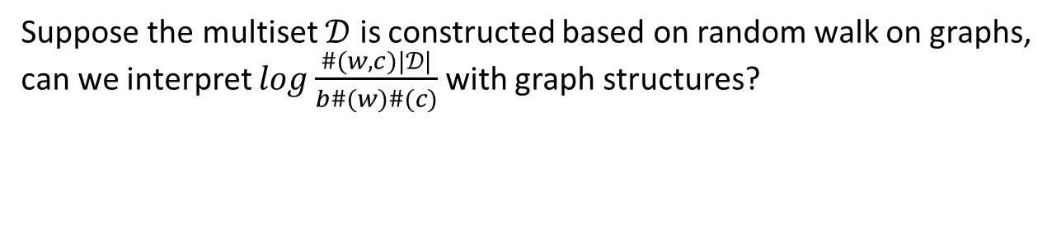
Understanding random walk + skip gram
Suppose the multiset $𝒟$ is constructed based on random walk on graphs, can we interpret $\log{\frac{\#(w,c)|𝒟|}{b\#(w)\#(c)}}$ with graph structures?

Slide 33
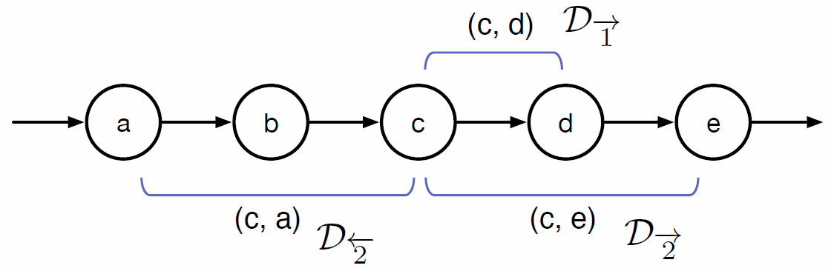
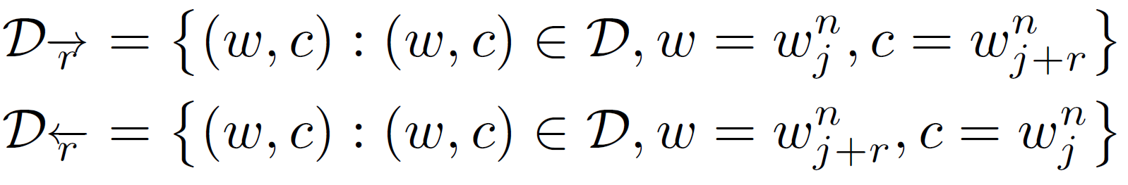
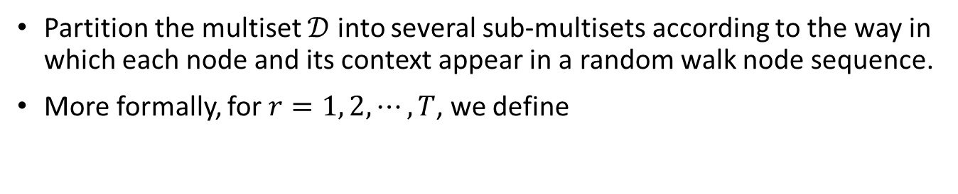
Understanding random walk + skip gram
Partition the multiset $𝒟$ into several sub-multisets according to the way in which each node and its context appear in a random walk node sequence.
More formally, for $r=1, 2,⋯, T$, we define
Distinguish direction and distance

Slide 34
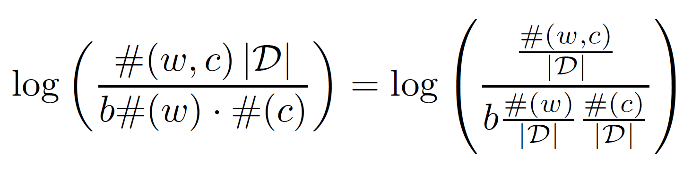
Understanding random walk + skip gram

Slide 35
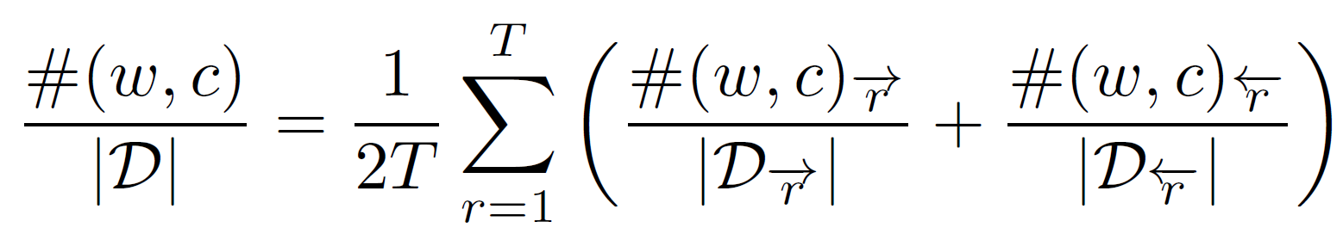
Understanding random walk + skip gram

Slide 36
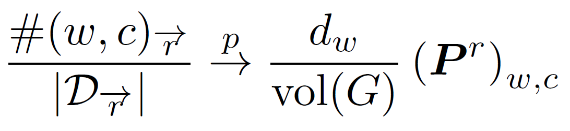
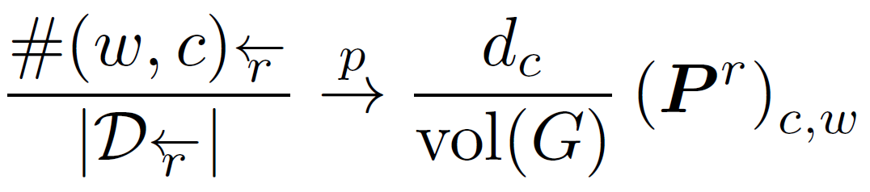


Understanding random walk + skip gram
the length of random walk $L→∞$

Slide 37

Understanding random walk + skip gram
the length of random walk $L→∞$

Slide 38

Understanding random walk + skip gram
the length of random walk $L→∞$

Slide 39

Understanding random walk + skip gram
the length of random walk $L→∞$

Slide 40


Understanding random walk + skip gram

Slide 41

Understanding random walk + skip gram
$$w_{i−2 }$$
$$w_{i−1 }$$
$$w_{i}$$
$$w_{i+1 }$$
$$w_{i+2 }$$
DeepWalk is asymptotically and implicitly factorizing
$$A$$
Adjacency matrix
$$D$$
Degree matrix
$$vol\left(G\right)=\sum_{i}{\sum_{j}{A_{ij}}}$$
b: #negative samples
T: context window size
Qiu et al. Network embedding as matrix factorization: unifying deepwalk, line, pte, and node2vec. In WSDM’18. The most cited paper in WSDM’18 as of May 2019

Slide 42
Unifying DeepWalk, LINE, PTE, & node2vec as Matrix Factorization
DeepWalk
LINE
PTE
node2vec
Qiu et al. Network embedding as matrix factorization: unifying deepwalk, line, pte, and node2vec. In WSDM’18. The most cited paper in WSDM’18 as of May 2019

Slide 43
Can we directly factorize the derived matrices for learning embeddings?

Slide 44
NetMF: explicitly factorizing the DW matrix
$$w_{i−2 }$$
Matrix Factorization
$$w_{i−1 }$$
$$w_{i}$$
$$w_{i+1 }$$
$$w_{i+2 }$$
DeepWalk is asymptotically and implicitly factorizing
Qiu et al. Network embedding as matrix factorization: unifying deepwalk, line, pte, and node2vec. In WSDM’18. The most cited paper in WSDM’18 as of May 2019

Slide 45

NetMF
How can we solve this issue?
Construction
Factorization
$$S=$$
Qiu et al. NetSMF: Network embedding as sparse matrix factorization. In WWW 2019

Slide 46


NetMF
DeepWalk is asymptotically and implicitly factorizing
NetMF is explicitly factorizing
$S$ =
Recall that in random walk + skip gram based network embedding models:
$z_{v}^{⊤}z_{c}$ → the probability that node $v$ and context $c$ appear on a random walk path
$S$ =
$z_{v}^{⊤}z_{c}$ → the similarity score $S_{vc}$ between node $v$ and context $c$ defined by this matrix

Slide 47

NetMF for a small window size T

Slide 48

Experimental Setup

Slide 49

Experimental Results
Predictive performance on varying the ratio of training data;
The x-axis represents the ratio of labeled data (%)

Slide 50


Network Embedding
Random Walk
Skip Gram
Input:
Adjacency Matrix
$$A$$
Output:
Vectors
$$Z$$
$$S=f(A)$$
(dense) Matrix Factorization
NetMF
$$f\left(A\right) =$$

Slide 51


Challenges
$$S=$$
dense
NetMF is not practical for very large networks

Slide 52
NetMF
How can we solve this issue?
Construction
Factorization
$$S=$$
Qiu et al. NetSMF: Network embedding as sparse matrix factorization. In WWW 2019

Slide 53
NetSMF--Sparse
How can we solve this issue?
Sparse Construction
Sparse Factorization
$$S=$$
Qiu et al. NetSMF: Network embedding as sparse matrix factorization. In WWW 2019

Slide 54
Fast & Large-Scale Network Representation Learning
Qiu et al., NetSMF: Network embedding as sparse matrix factorization. In WWW 2019.
Tutorial @WWW 2019

Slide 55






Sparsify $S$
For random-walk matrix polynomial
where and non-negative
One can construct a $\left(1+ε\right)$-spectral sparsifier $\tilde{L}$ with non-zeros
in time
for undirected graphs
Dehua Cheng, Yu Cheng, Yan Liu, Richard Peng, and Shang-Hua Teng, Efficient Sampling for Gaussian Graphical Models via Spectral Sparsification, COLT 2015.
Dehua Cheng, Yu Cheng, Yan Liu, Richard Peng, and Shang-Hua Teng. Spectral sparsification of random-walk matrix polynomials. arXiv:1502.03496.

Slide 56

Sparsify $S$
For random-walk matrix polynomial
where and non-negative
One can construct a $\left(1+ε\right)$-spectral sparsifier $\tilde{L}$ with non-zeros
in time

Slide 57

Sparsify $S$
For random-walk matrix polynomial
where and non-negative
One can construct a $\left(1+ε\right)$-spectral sparsifier $\tilde{L}$ with non-zeros
in time

Slide 58

Sparsify $S$
For random-walk matrix polynomial
where and non-negative
One can construct a $\left(1+ε\right)$-spectral sparsifier $\tilde{L}$ with non-zeros
in time

Slide 59


NetSMF --- Sparse
Factorize the constructed matrix

Slide 60
NetSMF --- Sparse
Factorize the constructed matrix

Slide 61

NetSMF --- Sparse

Slide 63




NetSMF---bounded approximation error
$$M$$
$$\tilde{M}$$

Slide 64


Slide 65


Slide 66


Slide 67


Slide 68

Network Embedding
Random Walk
Skip Gram
DeepWalk, LINE, node2vec, metapath2vec
Input:
Adjacency Matrix
$$A$$
Output:
Vectors
$$Z$$
$$S=f(A)$$
(dense) Matrix Factorization
NetMF
Sparsify $S$
(sparse) Matrix Factorization
NetSMF

Slide 69
Much More Fast and Scalable Network Representation Learning
Zhang et al., ProNE: Fast and Scalable Network Representation Learning. In IJCAI 2019

Slide 70

Network Embedding
Random Walk
Skip Gram
DeepWalk, LINE, node2vec, metapath2vec
Input:
Adjacency Matrix
$$A$$
Output:
Vectors
$$Z$$
$$S=f(A)$$
(dense) Matrix Factorization
NetMF
Sparsify $S$
(sparse) Matrix Factorization
NetSMF
$$f\left(A\right) =$$

Slide 71

ProNE: More fast & scalable network embedding

Slide 72



Embedding enhancement via spectral propagation
$$R_{d}←D^{−1}A(I_{n}−\tilde{L}){ R}_{d}$$
is the spectral filter of $L=I_{n}−D^{−1}A$
$D^{−1}A(I_{n}−\tilde{L})$ is $D^{−1}A$ modulated by the filter in the spectrum

Slide 73




Chebyshev Expansion for Efficiency
To avoid explicit eigendecomposition and Fourier transform
Chebyshev expansion

Slide 74

Efficiency
20 Threads
19hours 98mins
1.1M nodes

Slide 75

Efficiency
20 Threads
1 Thread
19hours 98mins
10mins
1.1M nodes
ProNE offers 10-400X speedups
(1 thread vs 20 threads)

Slide 76



Scalability & Effectiveness
Embed 100,000,000 nodes by one thread:
29 hours with performance superiority

Slide 77

Efficiency
Embed 100,000,000 nodes by one thread:
29 hours
$\frac{p}{log(p)}×$ speedup

Slide 78
Effectiveness
Embed 100,000,000 nodes by one thread:
29 hours with performance superiority

Slide 79

Embedding enhancement

Slide 80


A general embedding enhancement framework

Slide 81

Network Embedding
Random Walk
Skip Gram
DeepWalk, LINE, node2vec, metapath2vec
Input:
Adjacency Matrix
$$A$$
Output:
Vectors
$$Z$$
$$S=f(A)$$
(dense) Matrix Factorization
NetMF
Sparsify $S$
(sparse) Matrix Factorization
NetSMF
(sparse) Matrix Factorization
$$Z=f(Z′)$$
ProNE

Slide 82
Tutorials & Open Data
Representation learning on networks
Tutorial at WWW 2019
~500 slides at https://www.aminer.cn/nrl_www2019
Computational models on social & information network analysis
Tutorial at KDD 2018
~400 slides at https://www.aminer.cn/kdd18-sna
Bi-Weekly Microsoft Academic Graph Updates
Spark & Databricks on Azure
https://docs.microsoft.com/en-us/academic-services/graph/
The data is FREE!
Open Academic Graph
Joint work with AMiner@Tsinghua University
https://www.openacademic.ai/oag/
See detail at Zhang et al. KDD 2019.

Slide 83
Microsoft Academic Graph
664,195 fields of study
48,728 journals
4,391 conferences
219 million papers/patents/books/preprints
240 million authors
25,512 Institutions
https://academic.microsoft.com as of May 25, 2019

Slide 84
References
F. Zhang, X Liu, J Tang, Y Dong, P Yao, J Zhang, X Gu, Y Wang, B Shao, R, K. Wang. OAG: Toward Linking Large-scale Heterogeneous Entity Graphs. ACM KDD 2019.
Jiezhong Qiu, Yuxiao Dong, Hao Ma, Jian Li, Chi Wang, Kuansan Wang, and Jie Tang. NetSMF: Large-Scale Network Embedding as Sparse Matrix Factorization. WWW 2019.
Jie Zhang, Yuxiao Dong, Yan Wang, Jie Tang, and Ming Ding. ProNE: Fast and Scalable Network Representation Learning. IJCAI 2019.
Jiezhong Qiu, Yuxiao Dong, Hao Ma, Jian Li, Kuansan Wang, and Jie Tang. Network Embedding as Matrix Factorization: Unifying DeepWalk, LINE, PTE, and node2vec. WSDM 2018.
Yuxiao Dong, Nitesh V. Chawla, Ananthram Swami. metapath2vec: Scalable Representation Learning for Heterogeneous Networks. KDD 2017.
Yuxiao Dong, Reid A. Johnson, Jian Xu, Nitesh V. Chawla. Structural Diversity and Homophily: A Study Across More Than One Hundred Big Networks. KDD 2017.
Yuxiao Dong, Reid A. Johnson, Nitesh V. Chawla. Will This Paper Increase Your h-index? Scientific Impact Prediction. WSDM 2015.

Slide 85
Thank you!

